Slide 2
Holter Training
Edan Instruments, Inc.
www.edan.com.cn
info@edan.com.cn
Mar. 1, 2016

Slide 3
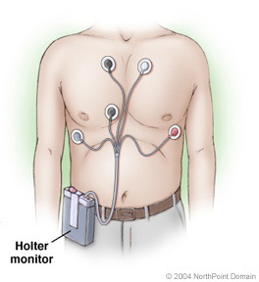
What is Holter?
Holter (ambulatory electrocardiography, AECG) is a portable device for continuously monitoring various electrical activity of the cardiovascular system for at least 24 hours.
Advantage of Holter
Continuously Monitoring
Long-time Sampling
Non-invasive test
Doesn’t affect patient’s daily life
Riskless and painless

Slide 4
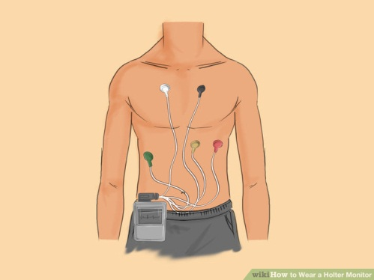
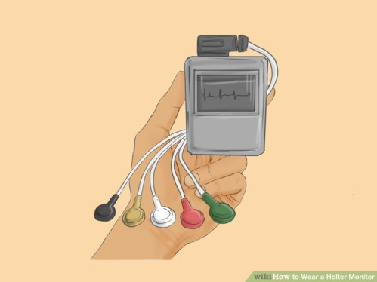
How to proceed a Holter Monitoring?
1. Schedule an appointment with the cardiologist to get the monitor.
4. You may take notes to mark the events like feeling dizzy or chest pain.
2. Attach the Holter. Typically, a monitor is worn for 24 to 72 hours.
5. When the data measurement period is over, return the device.
3. Conduct your normal activities while wearing the Holter.
6. Your data will be load into the Holter Software and analyzed by doctor.

Slide 5
When does patient need Holter Monitoring?
When patient shows symptoms include chest pains, shortness of breath, palpitations, needs to confirm the cause of the disease.
When patient shows arrhythmia, needs to have the qualitative analysis and quantitative analysis and to evaluate the risk.
When patient shows symptoms of ischemia, needs to have the qualitative analysis and quantitative analysis.
When patient feels angina pectoris, needs to confirm the type of disease and have accessory information of coronary heart disease.
Prognosis evaluation for Myocardial Infraction (MI) patient.
Assessment for Percutenous transluminal coronary angioplasty (PTCA) patient to see if restenosis occurs or not.
Evaluation for Sinus Node function.
Assessment for Pacemaker function.
Evaluation of therapeutic efficiency of antiarrhythmic anti-myocardial ischemia medicine.

Slide 6
What kind of information can be acquired from Holter Analysis Software?
Anisorhythmia
Sinus Bradycardia
Sinus Tachycardia
Superventricular premature beat (SVE)
Ventricular premature beat (VE)
Bundle Branch Block (BBB)
Asystole/Sinus arrest
Atrial fibrillation/Atrial flutter
Ventricular Tachycardia
ST segment elevation/depression
..........
Based on the analysis of the ECG above and the patient’s other Clinical manifestation, cardiologist deduces the disease of the patient.

Slide 7
What kind of information can be acquired from Holter Analysis Software?
Anisorhythmia
Rhythm shows irregular, sometimes varying with respiration.
Notes:
心律不齐：RR间期不等，波形正常。

Slide 8
What kind of information can be acquired from Holter Analysis Software?
Sinus Bradycardia
Rhythm shows regular, Heart Rate Slow (< 60 bpm), P Wave Normal
Notes:
窦性心动过缓：HR小于60（视年龄而定），软件可以调节判定的门槛

Slide 9
What kind of information can be acquired from Holter Analysis Software?
Sinus Tachycardia
Rhythm shows regular, Rate Fast (> 100 bpm), P Wave Normal, may merge with T wave at very fast rates
Notes:
窦性心动过速：HR大于100（视年龄而定），软件可以调节判定的门槛

Slide 10
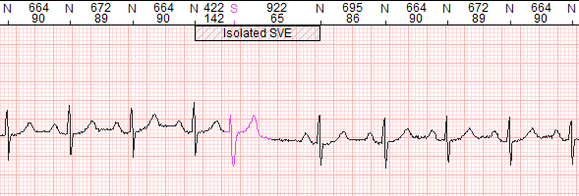
What kind of information can be acquired from Holter Analysis Software?
Superventricular premature beat (SVE)
Premature Junctional Complex or Premature Atrial Complex, with absent or premature P wave, normal QRS shape but a sudden shorten RR interval,
Notes:
室上性早搏：P波隐匿，QRS波T波正常，RR间期提前。

Slide 11
What kind of information can be acquired from Holter Analysis Software?
Ventricular premature beat (VE)
Rhythm shows Irregular, P Wave Absent, QRS Wide (> 0.10 sec), bizarre appearance.
Notes:
室性早搏：宽大畸形QRS波，P波隐匿，RR间期提前。

Slide 12
What kind of information can be acquired from Holter Analysis Software?
Bundle Branch Block (BBB)
Second Degree Heart Block Type I
Rhythm Irregular but with progressively longer PR interval lengthening until a QRS complex is missed.
Second Degree Heart Block Type II
Rhythm Regular (atrial) and irregular (ventricular)
Rate Characterized by Atrial rate usually faster than ventricular rate.
Notes:
二度一型传导阻滞：PR间期逐渐延长，直到丢失一个QRS波。
二度二型传导阻滞：固定几个心拍后丢失一个QRS波T波。

Slide 13
What kind of information can be acquired from Holter Analysis Software?
Bundle Branch Block (BBB)
Third Degree Heart Block
Rhythm Regular, but atrial and ventricular rhythms are independent. Characterized by Atrial rate usually faster than ventricular rate .
First Degree Heart Block
Rhythm Regular
PR Interval Prolonged (>0.20 sec)
Notes:
三度传导阻滞：有P波无QRS波，P波和QRS波没有关系。
一度传导阻滞：PR间期长于0.2sec
A first degree AV block occurs when electrical impulses moving through the Atrioventricular (AV) node are delayed (but not blocked). First degree indicates slowed conduction without missed beats.

Slide 14
What kind of information can be acquired from Holter Analysis Software?
Asystole/Sinus arrest
Asystole
Rhythm Not present
P Wave Absent
QRS Absent
Sinus arrest
Rhythm Irregular due to pause
Notes:
心搏停止
窦性停搏

Slide 15
What kind of information can be acquired from Holter Analysis Software?
Atrial fibrillation/Atrial flutter
Atrial Fibrillation
P Wave Absent - erratic waves are present
Rate can be very fast (> 350 bpm)
Atrial Flutter
Rate Fast (250-350 bpm) for Atrial, but ventricular rate is often slower.
P Wave Not observable, but saw-toothed flutter waves are present
Notes:
房颤：HR极速，RR间期短，QRS波无规律，P波消失
房扑：HR极速，P波无规律持续锯齿状。

Slide 16
What kind of information can be acquired from Holter Analysis Software?
Ventricular Tachycardia
Rate Fast (100-250 bpm), P Wave Absent, QRS Wide (>0.10 sec), bizarre appearance
Notes:
室速：HR极速，RR间期短，QRS宽大畸形，P波消失

Slide 17
The General Workflow

Slide 18
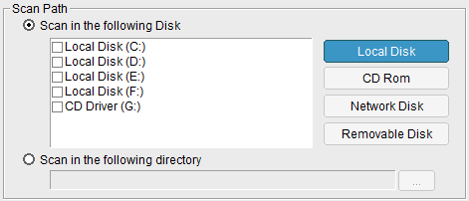
1. Load the data
Single input and Batch input
Edan Holter Analysis Software support two methods for data inputting: Single input and Batch input. It automatically searches the data without setting the directory, eliminating tedious tasks.
Flexible
Data Scan
Single Input
Batch Input
The software automatically scan the disk and load all the ECG data.
The software automatically find the Recorder and load one copy of ECG data.
Fast-loading
EDAN Holter analysis software realizes a very short loading time (less than 8 seconds for 3-channel Data) for one patient data, faster and faster.
≤
20
seconds
70%

Slide 19
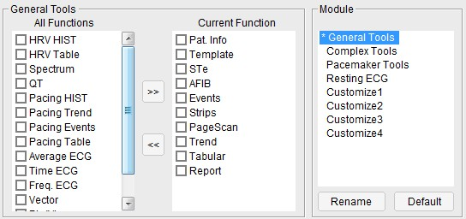
2. Select the workflow
2
Smooth Workflow
The Commonly used functions are placed at the top toolbar to facilitate your workflow. Combining with the auxiliary functions (R-R Histogram, Waveform Superposition), users can experience a very smooth and comfortable workflow.
1
4
3
User-defined toolbar
The top toolbar can be defined by users based on their preference, which brings clinicians a customized workflow. Let the software fit your preference, but not you adapt to the software.
3
1
2
4
User-define
Toolbar
The commonly used functions are preset with a user-friendly workflow. You can switch into different analyzing modules with corresponding functions.
You can also change the preset analyzing modules or create a new module with user-defined functions based on your own practice habit

Slide 20
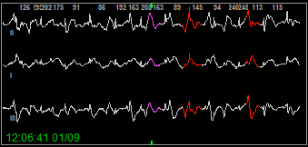
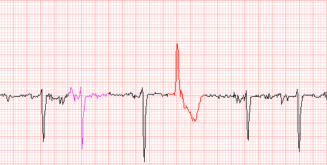
3. Check the template categorize
Color coded
templates
Color coded templates classification
Based on the QRS morphology features, beats signal will be automatically categorized as Normal, VE, SVE, Pace, Artifacts and Others, with corresponding color codes. You can notice the segment in one glance.
10
Templates
Template Categorize
Segment Graph
Electrocardiogram

Slide 21
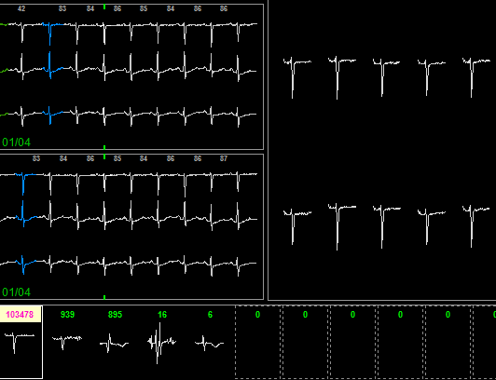
3. Check the template categorize
Sub-QRS
classification
Sub-templates Classification
Each automatically categorized template is separated into several sets as sub-templates, which brings you multilevel classification for ECG morphologies with organized batching procedures.
10
Templates
V
1
2
3
4
Detailed QRS segment
Every single QRS segment is displayed in this area for detailed checking and classification.
Sub-template
Based on QRS morphology features, each QRS template is divided into sub-templates. This function helps you with multi-level batch modification on QRS categorizing.

Slide 22
3. Check the template categorize
The interactive tools provide you with information and control to quickly group beat morphology.
Match QRS
By Type
Match QRS by Type
Matching QRS by Type helps to batch categorize QRS complex whose morphology features are similar with the one you confirmed. This is an automatically reverse selection, avoiding manually checking QRS complex one by one.
10
Templates
V
Match QRS
by Premature
Match QRS by Premature
By setting the timing advance value, QRS complex can be automatically divided into the higher group and the lower group base on the paling. This function helps to exam ventricular escape and premature ventricular contraction efficiently.
10
Templates
%
Del Artifact
Del Artifact
By selecting a certain segment as artifact, this function helps you to filter out all the artifacts similar with the chosen one in this sub-template group.
10
Templates
Del

Slide 23
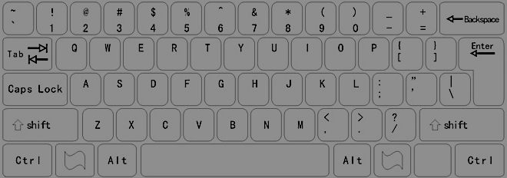
3. Check the template categorize
Fast
editing
Fast-editing
QRS templates editing is one of the most common operation. Users are able to edit the QRS classification by simply pressing “A/S/V/X/N” buttons on the PC keyboard.
A
S
V
X
N
Format
Painter
Format Painter
Use the Format Painter to quickly edit QRS classification by simply select single or batch waveform, which improves your work efficiency to a large extent.
N
V
S
A
X
Del
aP
vP
avP
Ea
Ev
En
LB
RB
A fast editing toolbar helps to quickly modify and categories QRS waveforms.
While you can also use the keyboard shortcut with QRS Definition.
Ea
Ev
RB
aP
vP
A
S
Del
En
avP
LB
X
V
N

Slide 24
3. Check the template categorize
Assistant tools for analysis
Finding the distinct waveforms is a time-consuming part of Holter analysis. With the help of a series of assistant tools of EDAN Holter Analysis Software, the process seams to be more than easy to finish.
Assistant Tools
R-R Histogram
A group of Interval Histogram is provided an easy access to analyze all the heart beats with different intervals, which helps to quickly locate the infrequent segments and also provides a brief understanding of the patient cardiac condition.

Slide 25
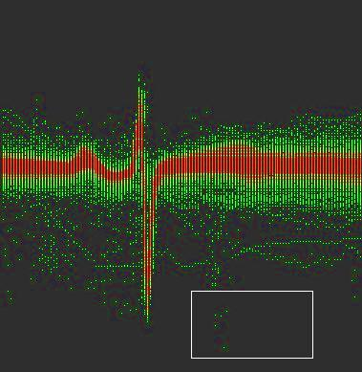
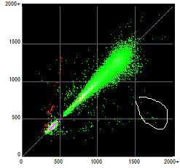
3. Check the template categorize
Assistant tools for analysis
Finding the distinct waveforms is a time-consuming part of Holter analysis. With the help of a series of assistant tools of EDAN Holter Analysis Software, the process seams to be more than easy to finish.
Assistant Tools
Waveform Superposition Heat Map
The Waveform Superposition Heat Map shows overlapping waveforms and exposes infrequent segments. This function delivers a quick reference to locate the distinct waveforms for you to review, making your practice more efficient.
Lorenz Plots (Poincare plot)
The Lorenz Plots shows the R-R intervals in a visualized way to quickly indicate the nonhomogeneous beat-to-beat variability. You can also reversely select the distinct plots to view the corresponding waveforms.

Slide 26
3. Check the template categorize
N
N
Smart Beats Batch Insert
When it comes with undetected heartbeat, inserting the tag one by one might be an extremely tiresome process. With the help of our Smart Beats Batch Insert function, you can mass insert the tags of undetected heartbeats by referring to another channel of waveform, or by referring to the previous RR intervals of the undetected part.
N
N
N
Batch
Insert
Together with the RR Histogram, you can easily find the segments with long RR-intervals which might include undetected heart beat. Using the smart beats batch insert function, you can avoid the undetected errors within several clicks.

Slide 27
4. ST Segment Analysis
Automatic ST Evaluation
The ST Elevation/Deviation can be automatically detected and presented in the ST Evaluation Chart, together with the ST color mapping, you can easily find the targeted segment you need.
ST
Evaluation
ST Evaluation Chart
Every heart beat is scanned automatically and all the ST elevation/deviation segments are picked and presented in this chart, where you can quickly check and locate the targeted segment.
ST trend Color Mapping
The ST trend Color Mapping shows elevation and deviation in red and green, providing a clear information of ST trend. Integrated with HR trend, it provides a quick reference when evaluate the acute myocardial infarction.

Slide 28
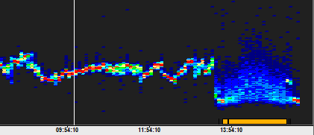
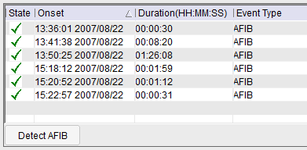
4. AFIB/FLUT Segment Analysis
Automatic AFIB/FLUT Segments detection
The atrial fibrillation/flutter segments also can be automatically detected and presented in the AFIB/FLUT Chart, where you can quickly locate the distinct period of waveforms and check.
AFIB/FLUT
Evaluation
Auto AFIB Detection Chart
Holter software automatically find the AFIB segments and list them in Chart for you to check. In addition, it support one-button operation to delete SVE in AFIB period, which helps to define the events more accurately.
AFIB/FLUT Histogram
Based on the RR interval distributions, the AFIB/FLUT Histogram helps you to find the distinctive atrial fibrillation/flutter period of waveforms quickly. You can locate the corresponding segment immediately by clicking at the Histogram.

Slide 29
5. Events Summarizing
VE Runs
Real-time updates Events
Every time you modify the QRS tag or define the Event of segment in any interface, the Event Summarizing Chart changes synchronously without any redundant refreshing.
Events
Event Summarizing Chart
Every segment defined as Event and all the abnormal heart beats are presented in this Chart for reviewing.
The Event Marker recorded by patient is also stored as Diary for reference.
highlight on waveform
The segment defined as Event is highlighted with corresponding mark, which is distinguishable when you scan the waveforms.

Slide 30
6. Page Scan
Intuitive Page Scan
To quick review all the heart beats and double check the abnormal segments, Page Scan is a quiet effective function. You can easily set up the speed, gain and intensity of QRS complex in one page, quickly scanning every heart beat of the patient.
Page Scan
Pause Scan Condition
The Page Scan function supports four kinds of “Pause Scan Condition” whose criteria can be fast modified in the toolbar. When it comes with the segments exceeding or going below certain limits, the page scanning will stop for further examining.

Slide 31
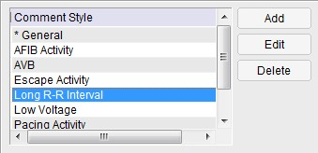
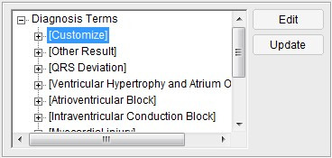
7. Report
Built-in Glossary
The built-in ECG glossary consists of rich diagnostic templates with detail feature descriptions and integrated diagnostic results, which helps clinicians draw conclusion effectively and efficiently.
Glossary
Personalized
Signature
Build-in
Glossary
One-button Comments
With the pre-configured report comments built-in, the contents you want to write in the report can be fast added by pressing only one button. The glossary can also be enriched with user-defined templates, while you can also edit the report manually.

Slide 32
Why EDAN?
With the well-designed workflow and the smart tool/functions,
EDAN Holter Analysis Software helps you save time in every practice.
Match QRS
By Type
Saving
40 seconds
in loading data
10
Templates
≤
20
seconds
V
70%
Saving
70% of time
in templates categorizing
N
Saving
70% of time
in mending leak detection
Match QRS
by Premature
N
N
10
Templates
N
N
%
Batch
Insert
Saving
50% of time
In finding distinct waveforms
Del Artifact
10
Templates
Del
Assistant Tools

Slide 33
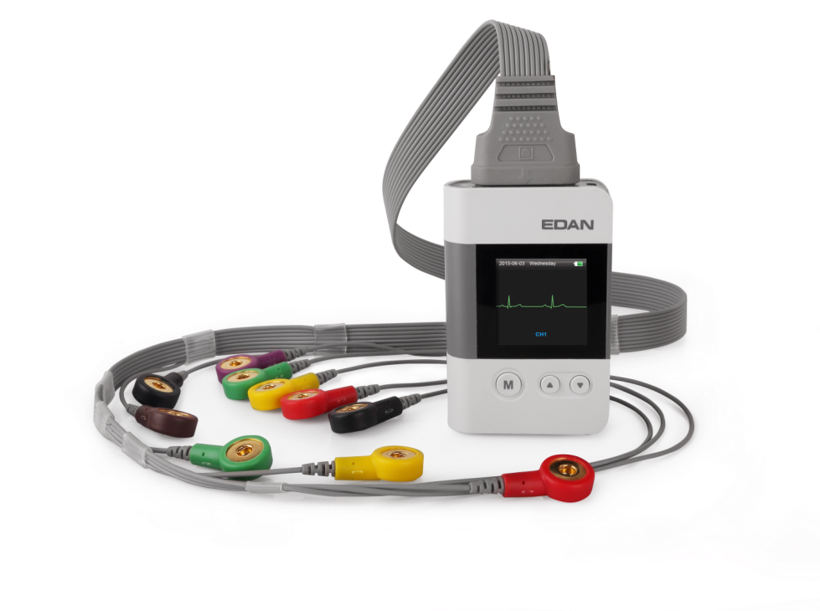
SE-2003&SE-2012
3/12-channel Holter Recorder

Slide 34
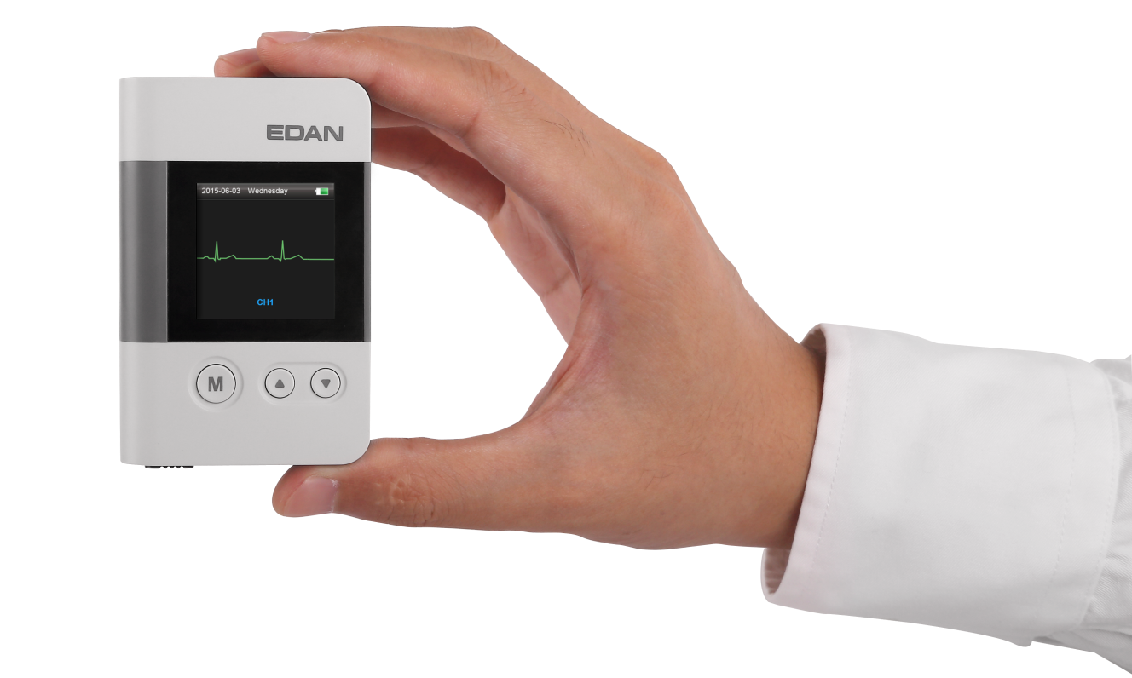
Compact & Ergonomics Design
Lightweight Design
The lightweight(50g) design makes EDAN Holter Recorder easily carried without bothering patient’s daily routine. With the smooth surface and the streamline modeling, it fits into the palm perfectly.
Pocket Size
Smooth edges
Compact size
Lightweight (50g)

Slide 35
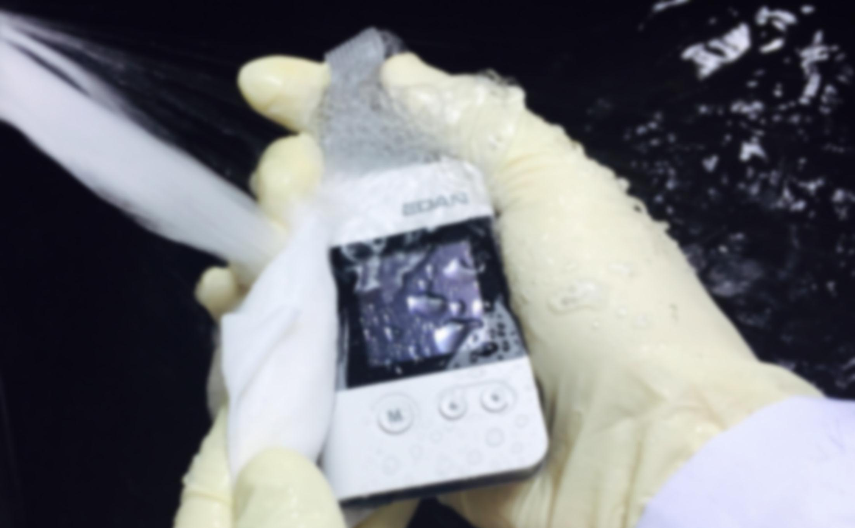
IP27 Waterproof Level
IP27
Great Waterproof Performance
EDAN’s Holter Recorder reaches protection grade up to IP27, intending to prevent unexpected damages from water or dust, which maximizes patients’ freedom in their daily life. The high level waterproofness facilitates the cleaning and sterilization procedure.
Water & Dust Proof

Slide 36
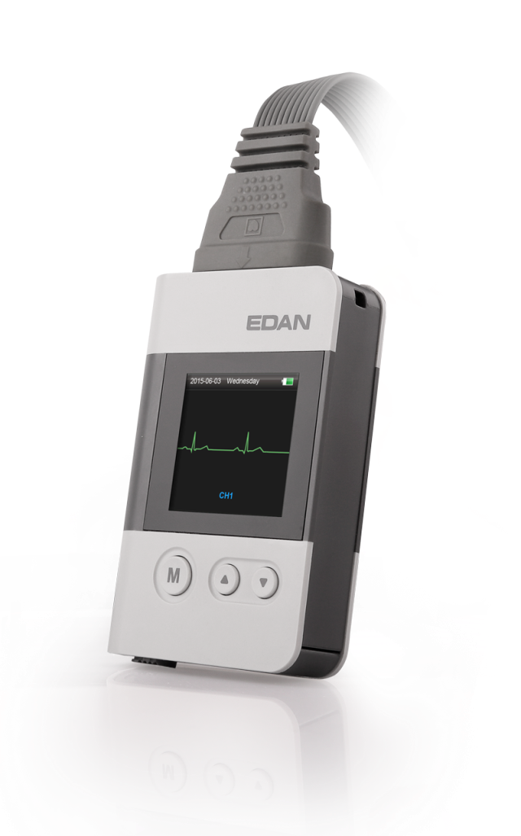
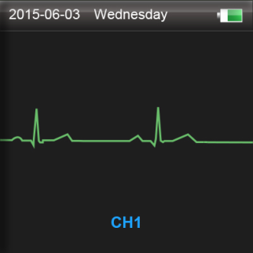
Real-time Waveform Display
OLED
Real-time Waveform Display
The Recorder applies an OLED Screen, through which you can see the ECG waveforms and wearing time at one glance. It also provides you the interface with several basic settings.
Display
You can have the basic settings without connecting the Recorder with PC,
For example:
Recording Time
You can select the recording time as 4/3/2/1 days or unlimited until battery off.
Patient ID
Set the patient ID on the recorder. It helps to distinguish the patient when data loaded in the PC.

Slide 37
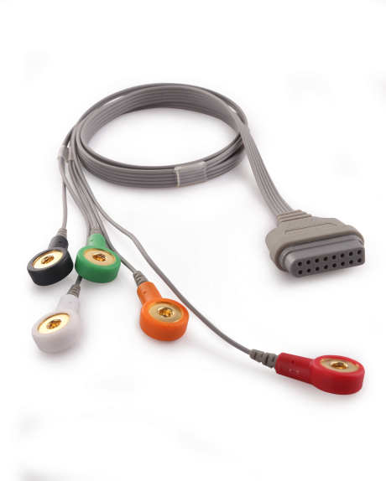
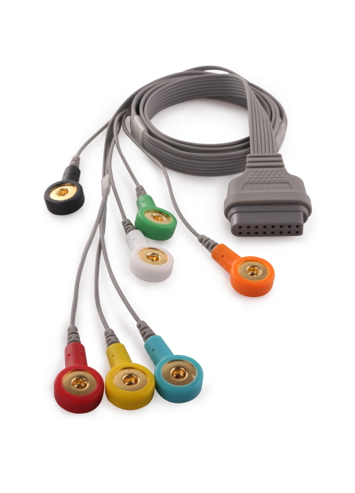
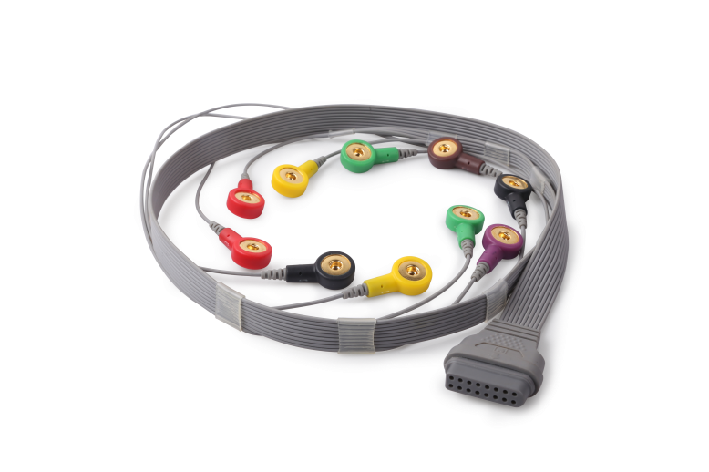
Auto 3/12-channel Identification
Auto 3/12-channel Identification
SE-2012 supports both 3-channel and 12-channel sampling. With the auto identification of 5/7/12-lead cables, SE-2012 can switch into corresponding sampling mode automatically.
3
2
1
Auto
5/7-lead Electrodes
3-channel ECG
10-lead Electrodes
3/12-channel ECG

Slide 38
Low Power Consumption
Long Time Sampling
EDAN Holter Recorder is designed with low power consumption, which enables it to support as long as 8 days recording with a single piece of Li-ion battery.
8
Days
Sampling Rate | 3-channel | 12-channel
128Hz | 219hours | 168hours
256Hz | 196hours | 124hours
512Hz | 100hours | 68hours
1024Hz | 90hours | 34hours

Slide 39
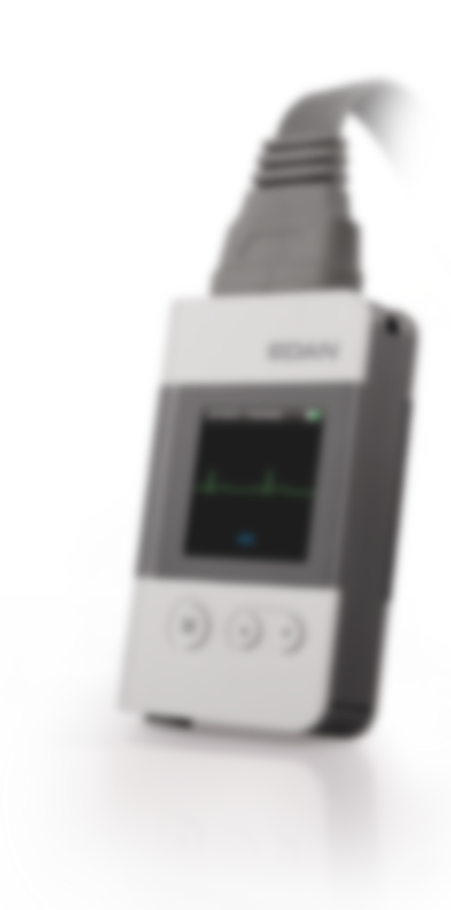
Event Marker
One-button Event Marker
During the sampling, patients may encounter some events like feeling heartache or falling down, which may bring abnormal signals on the waveforms. In this case, by long-pressing the “M” key, an Event Marker will be recorded in the data, which can be distinguished through the software analysis. These recorded information give doctors reference to make precise diagnosis.
M
Event Marker
Find the Event Markers in Events – “Diary”:

Slide 40
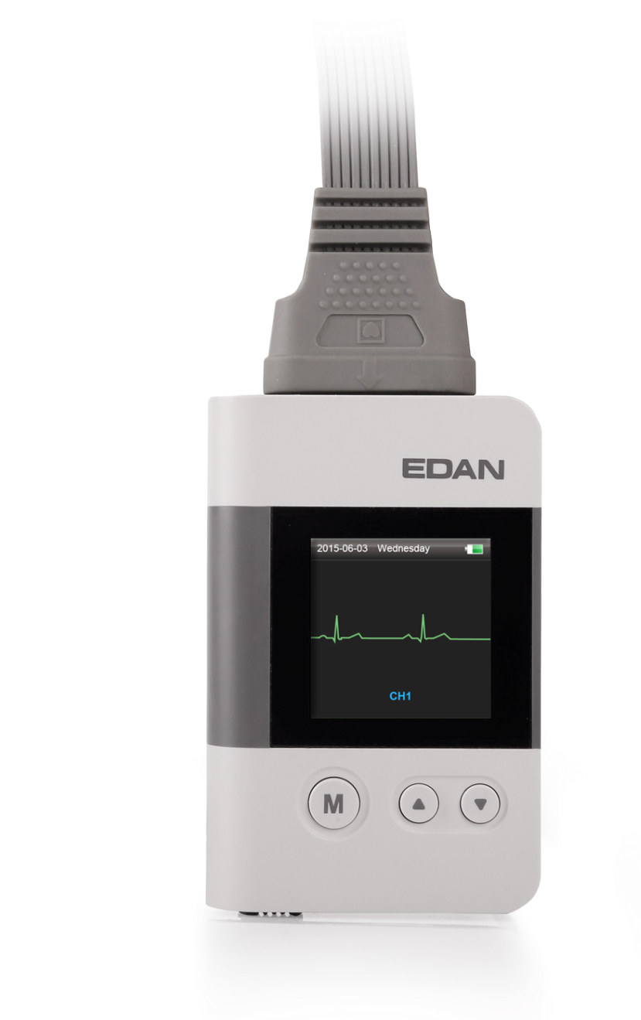
Accuracy
Event
Adjustable Sampling Rate
Four sampling rates (128/256/512/1024Hz) are selectable on the Recorder to ensure sampling accuracy under different patient’s conditions.
Sampling
Rate
Interference Resistance
SE-2003/2012 has applied the advanced anti-interference technique and design to guarantee the accurate ECG signal and the performance of interference resistance.
Interference
Resistance
P
Pacemaker Detection
EDAN applies the advanced technique of Multi-channel Pacemaker detection by using the special Hardware design. Combining with the software pacemaker analysis, no beats would be missed, which brings doctors confidence on making diagnosis.
Pacemaker
Detection

Slide 41
Highlights of
SE-2003/SE-2012 Sampling Box
P
3
2
1
Auto
Pocket Size
Pacemaker
Detection
OLED
IP27
Display
Water & Dust Proof
Interference
Resistance
M
Event
8
Days
Sampling
Rate
Event Marker

Slide 42
Highlights of
EDAN Holter Analysis Software
Color coded
templates
Match QRS
By Type
10
Templates
10
Templates
V
Page Scan
Flexible
Data Scan
ST
Evaluation
Sub-QRS
classification
Match QRS
by Premature
VE Runs
Glossary
≤
20
seconds
10
Templates
10
Templates
V
1
2
%
70%
3
4
Events
Personalized
Signature
Build-in
Glossary
2
Fast
editing
Del Artifact
1
4
A
S
10
Templates
V
X
N
Del
3
AFIB/FLUT
Evaluation
Format
Painter
N
N
3
N
1
2
4
N
N
User-define
Toolbar
Assistant Tools
Batch
Insert

Slide 43
THANK YOU
Edan Instruments, Inc.
www.edan.com.cn
Info@edan.com.cn
June. 7, 2016

