Slide 1

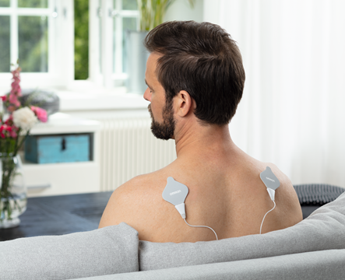
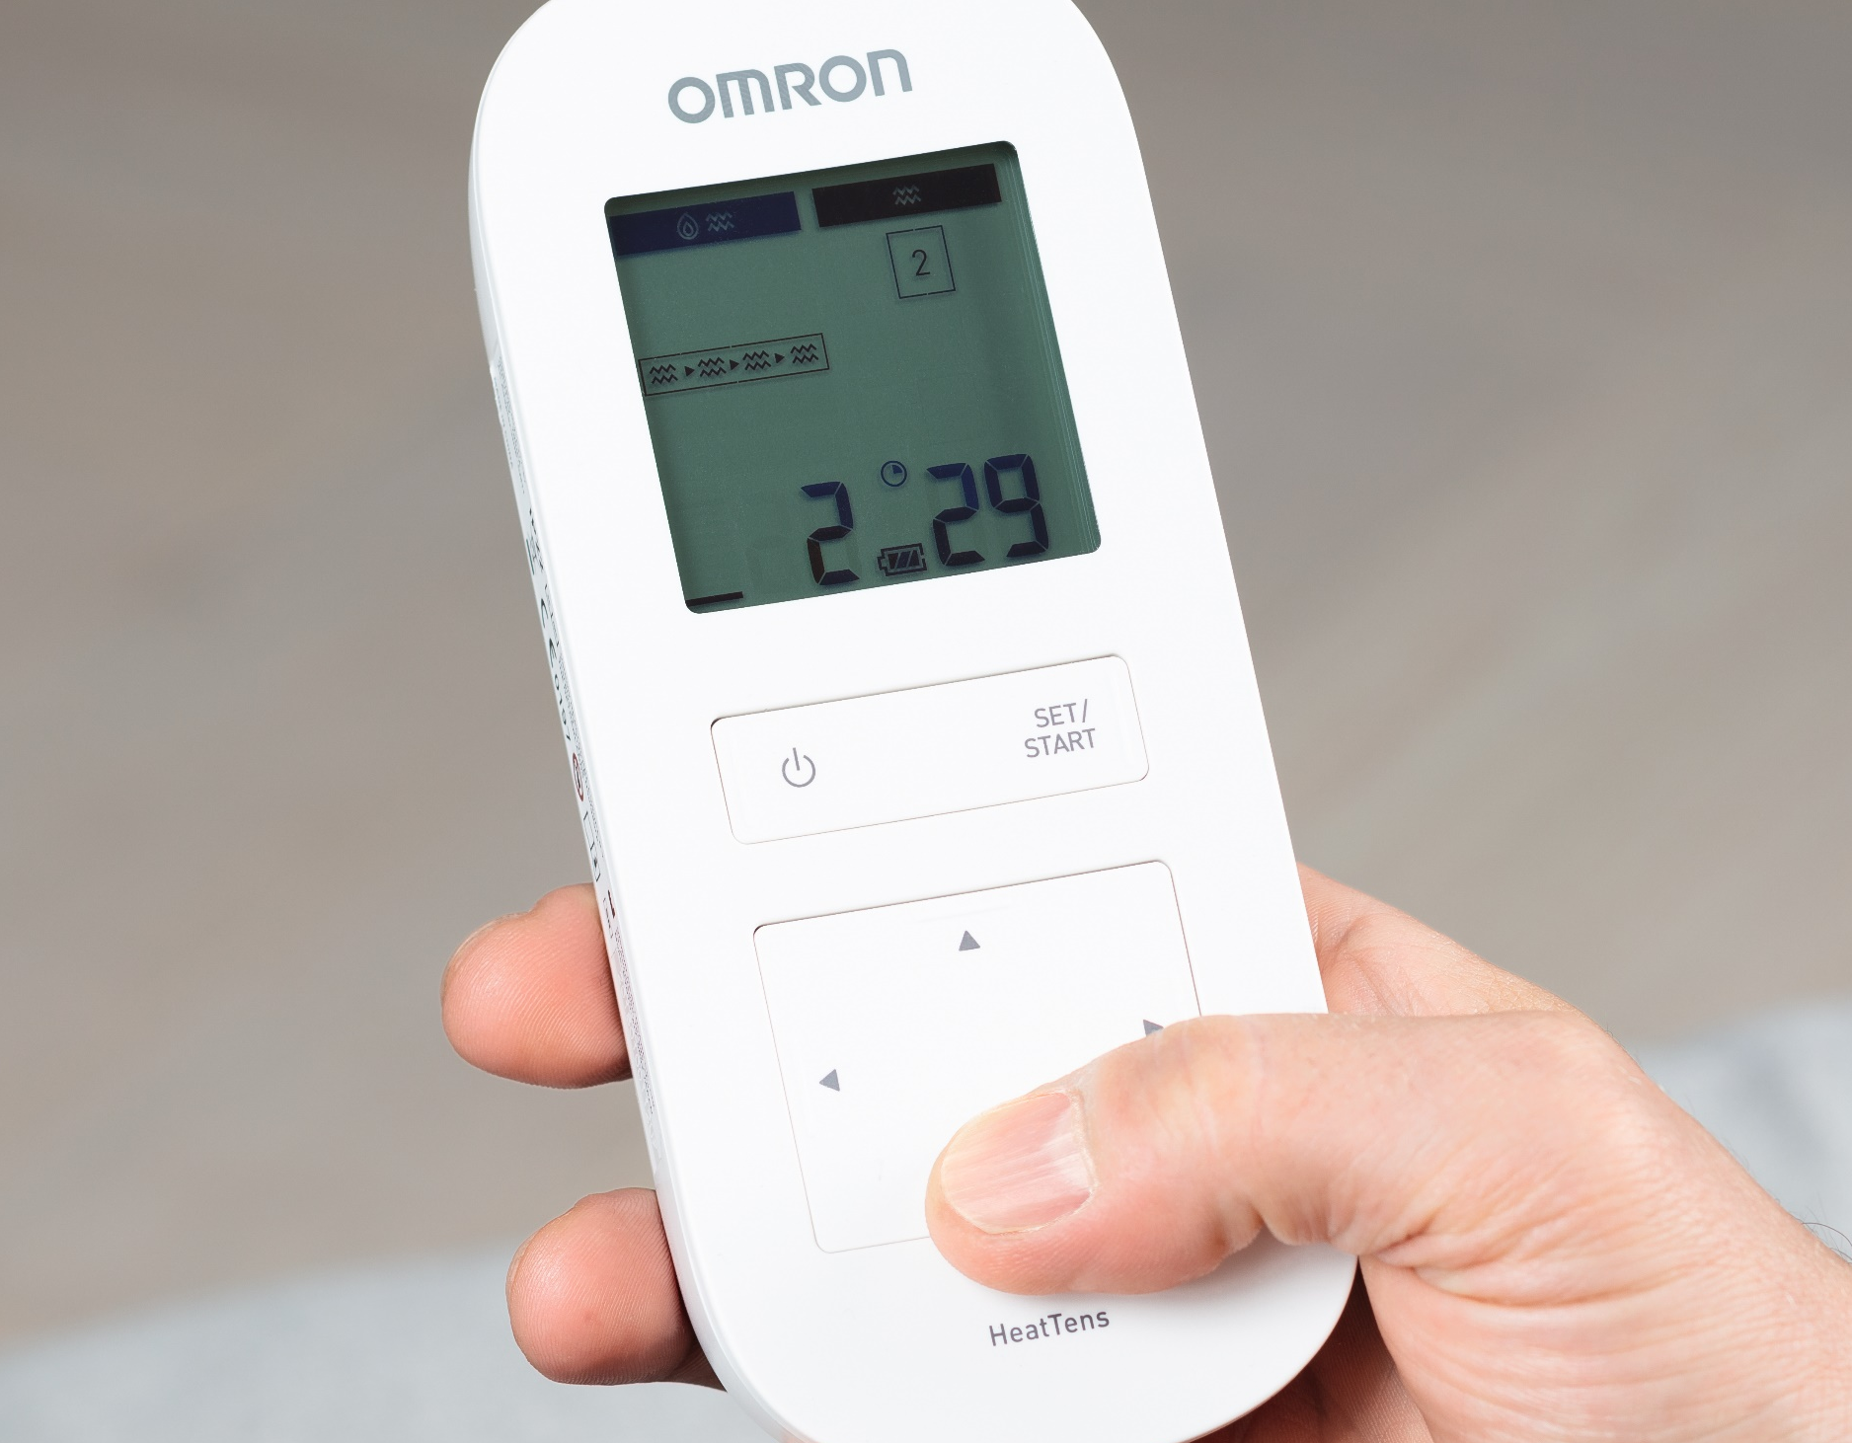
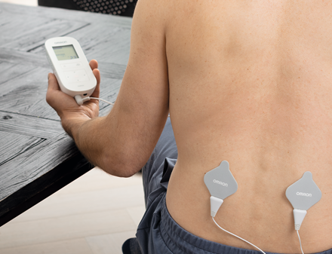

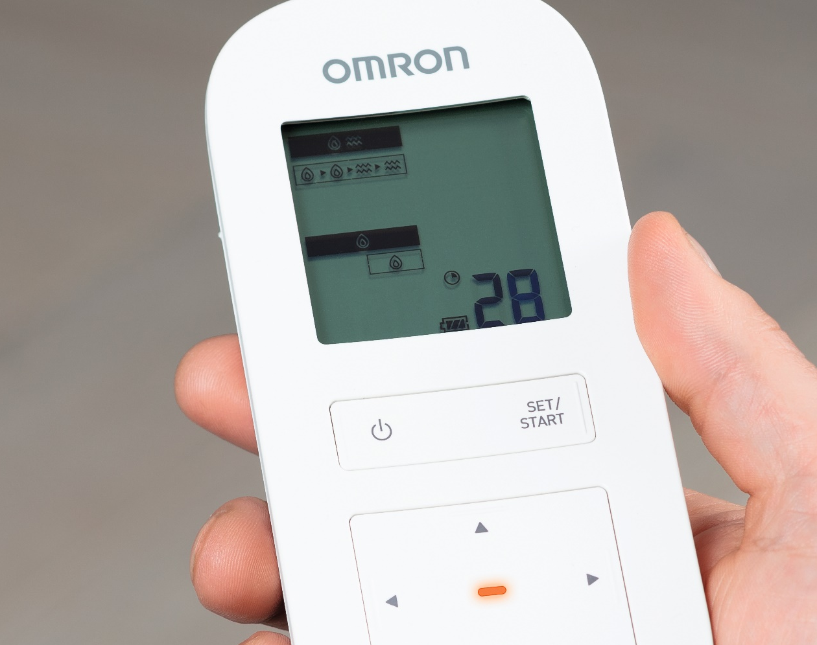
HeatTens (online) marketing text – 1
PM-00047-01-18-OHE
Drug-free pain relief
OMRON HeatTens relieves pain, is 100% drug-free and safe to use at home.
HeatTens is a certified medical device. It fulfills the strict safety and performance requirements for medical devices for home use.
Dual Therapy for muscle and joint pain
OMRON HeatTens combines soothing heat and TENS technology.
The heat increases metabolic activity, relaxes the muscles and soothes pain.
The TENS treatment uses electrical pulses to stimulate your body’s own natural pain relieving mechanisms.
Simple steps to customise the treatment
Step 1: Select your main therapy (2 combinations of HEAT and TENS treatment and 1 option without heat)
Step 2: Choose between 2 heat intensities.
Step 3. Choose the part of your body for a targeted treatment.
Triple action
Triple Action TENS technology helps to block the pain message,
triggers the release of endorphins and improves the blood circulation. TENS (Transcutaneous Electrical Nerve Stimulation) is a clinically proven technology¹ widely used by physiotherapists and pain specialists.
Recommended by our test panel
73% of users would recommend Omron HeatTens to others².
2 out of 3 users indicated they felt less pain after a week of usage.
Automatic programs to simplify your life
The pain reliever comes with automatic TENS programs for dedicated body zones: arms, back, legs, feet, joints, shoulders.
In addition it offers 3 generic massaging modes.
OMRON HeatTens works with gels on electrode pads. The gels last up to 30 uses and are replaceable.

Slide 2
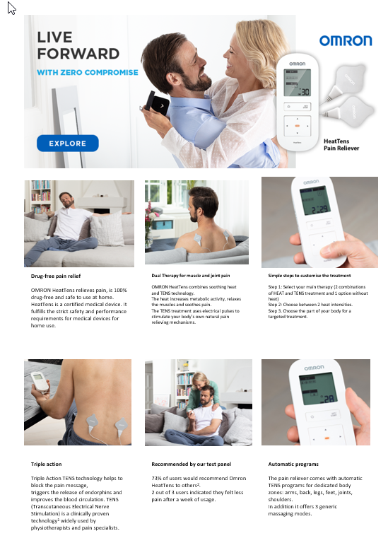
HeatTens (online) marketing text - 2
OMRON HeatTens is a drug-free pain reliever that combines soothing heat and clinically proven TENS technology to relieve muscle and joint pain. The heat relaxes the muscles and soothes your pain. The electrical pulses, which are comparable to the natural bioelectricity (body electricity), stimulate the body's pain relieving mechanism.
Highlights
Dual Therapy : Soothing heat and TENS technology to relieve muscle and joint pain
Customise your treatment : Select your main therapy (2 Heat + TENS combinations, 1 TENS only mode), pick lower/higher
heat intensity. Choose between 6 automatic programs for dedicated
body zones or one of the three generic massaging modes
Triple action TENS technology : (transcutaneous electrical nerve stimulation): helps to block the pain
            message, to trigger the release of endorphins and to improve blood circulation (as result of repeated muscle contracting and relaxing).
20 intensity settings
Rechargeable : No need to buy replacement batteries
Includes 2 sets of gels : Can be used up to 30 uses and are replaceable
LED indicator : Lights up when pads are heated
^{References:}
¹ Johnson M, Martinson M. Efficacy of electrical nerve stimulation for chronic musculoskeletal pain: A meta-analysis of randomized controlled trials. Pain 2007; 130 157-165
² Internal report. Usage test HeatTens. March 2018, n=59, Finland.

