Slide 1

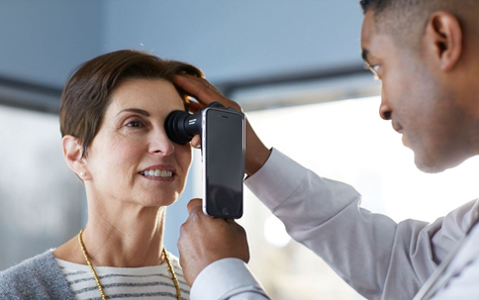
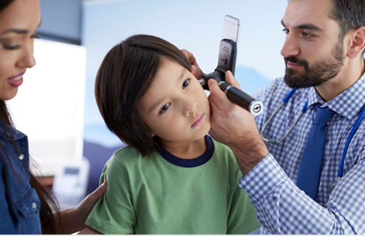
Executive Overview Enhance Launch EMEA
August 2020

Slide 2
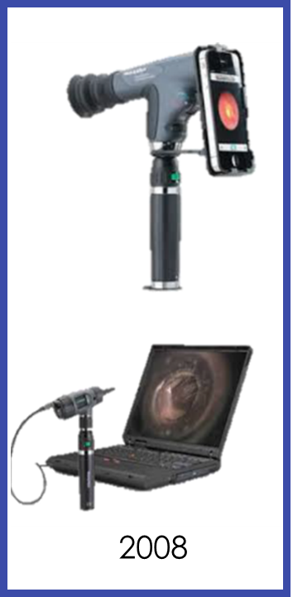
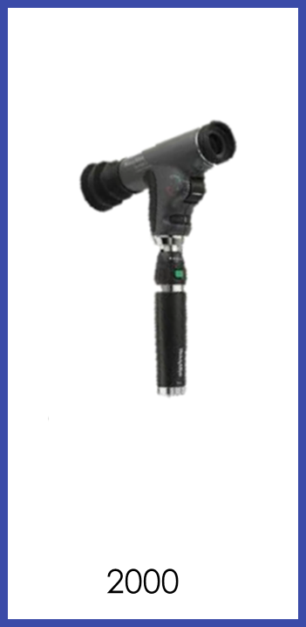

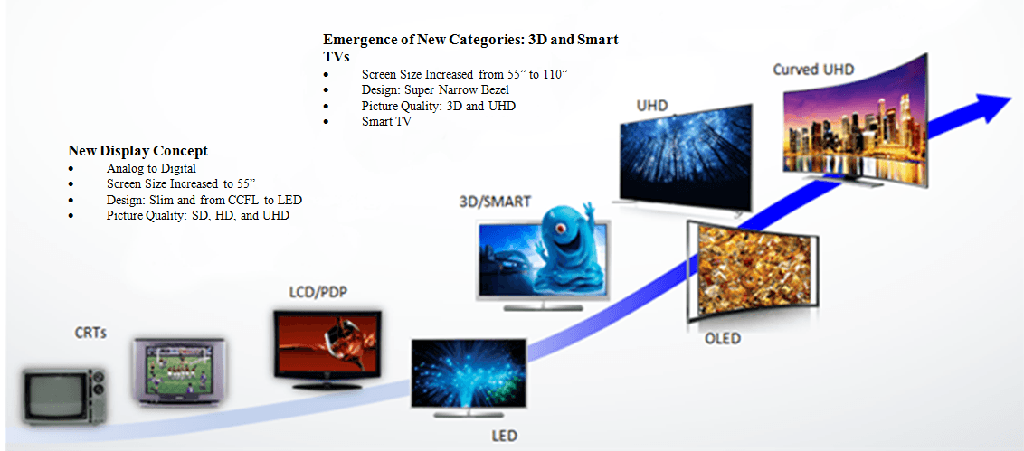
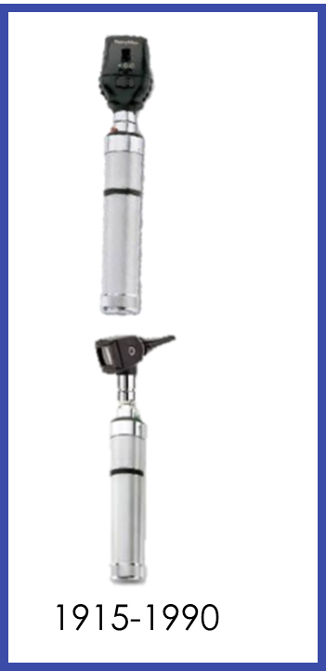


The evolution of 3.5 V Diagnostic devices is comparable to the evolution of TV devices………………

Slide 3
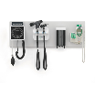
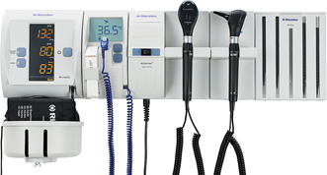

















Competition is Driving Continuous Improvement
 | WELCH ALLYN | RIESTER / ADC | HEINE
Wall Units
Diagnostic Heads
Student Sets
Unique Products
777 Integrated Wall System
Ri-former Diagnostic Station
EN200 Diagnostic Centre
NEW 2015
NEW 2017
1990
117 Oph
2000
PanOptic
2004
MacroView
NEW 2016
NEW 2015
NEW 2014
NEW USB handle
4 hour USB charge
NEW 2017

Slide 4
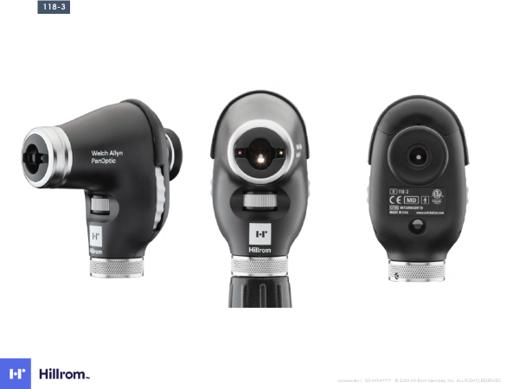
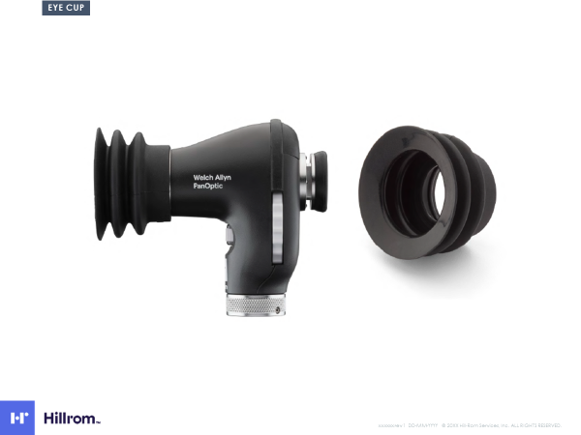
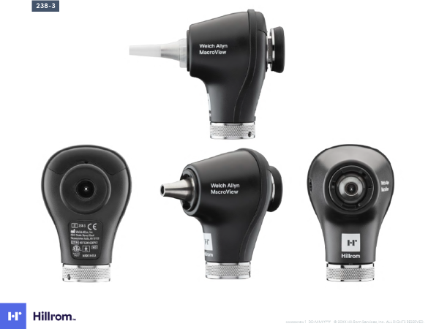
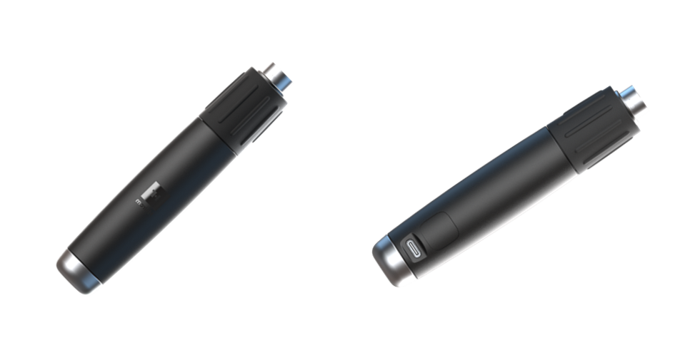
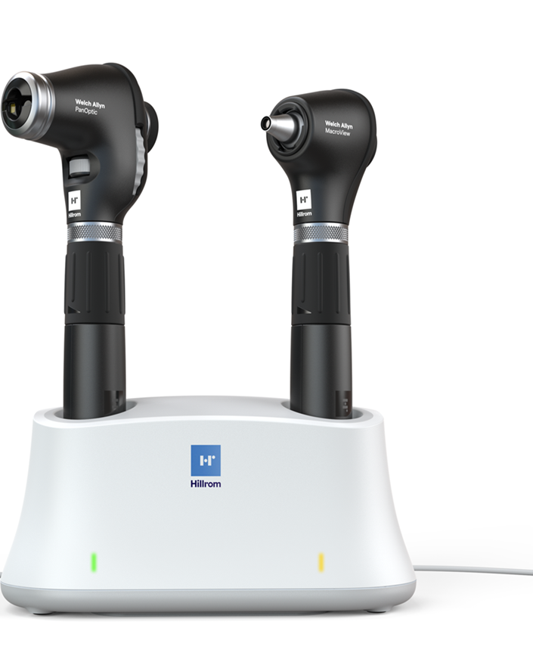
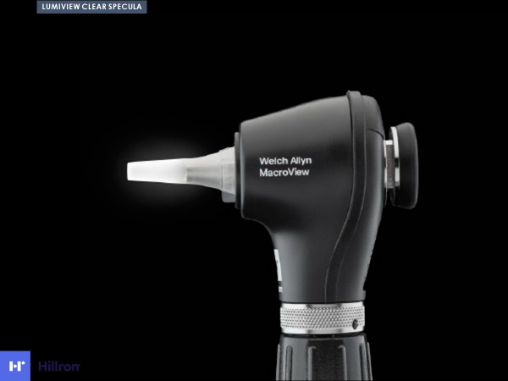
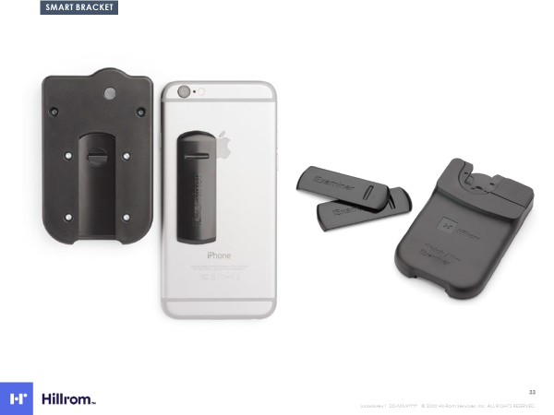
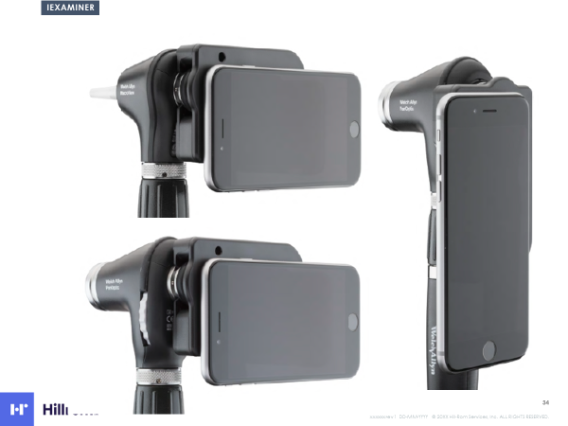
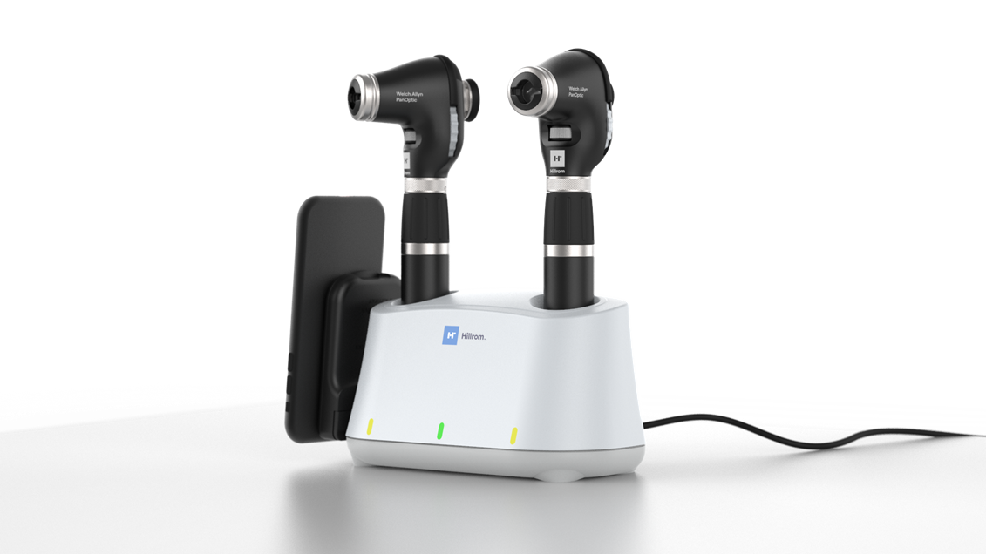
ENHANCE Launch consists out of
New heads ( better, best)
New handles
LumiView Clear Specula
New Charging (Table & USB)
Mobile phone bracket
App

Slide 5

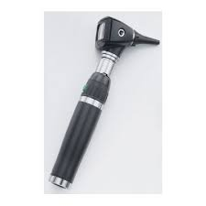
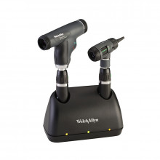
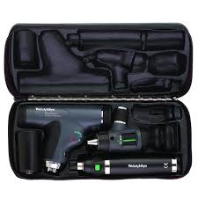

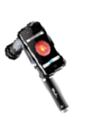
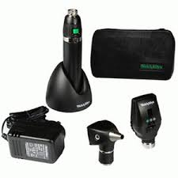
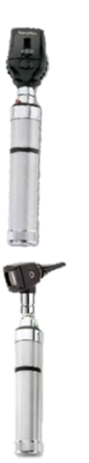
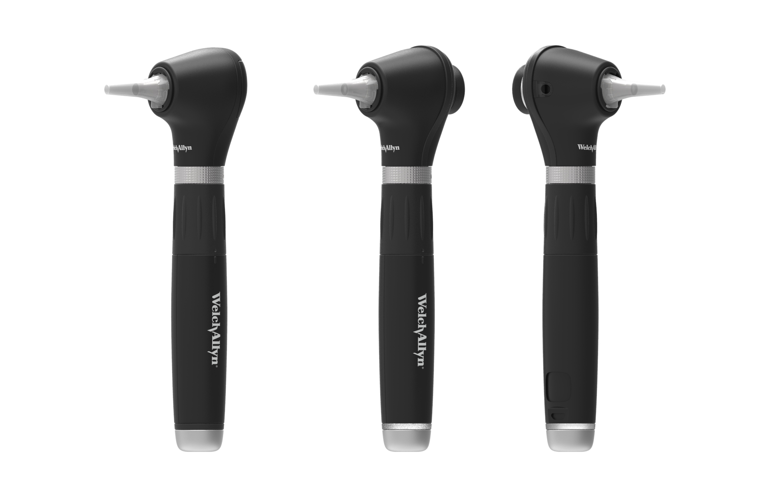
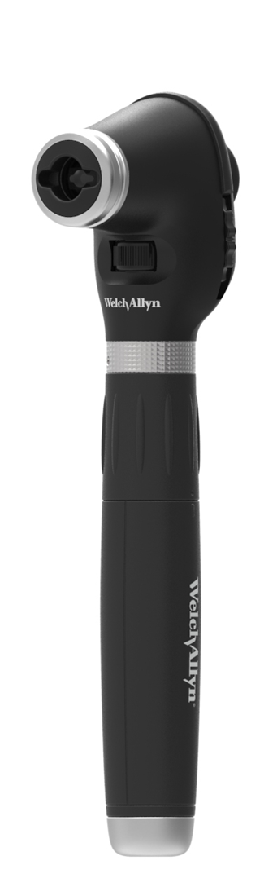
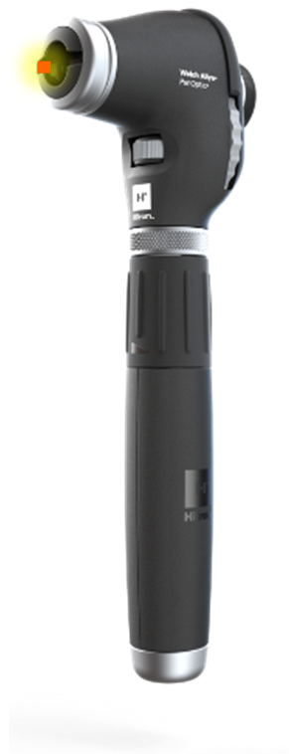
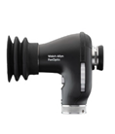
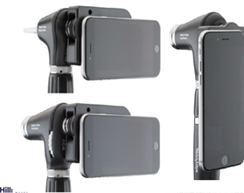
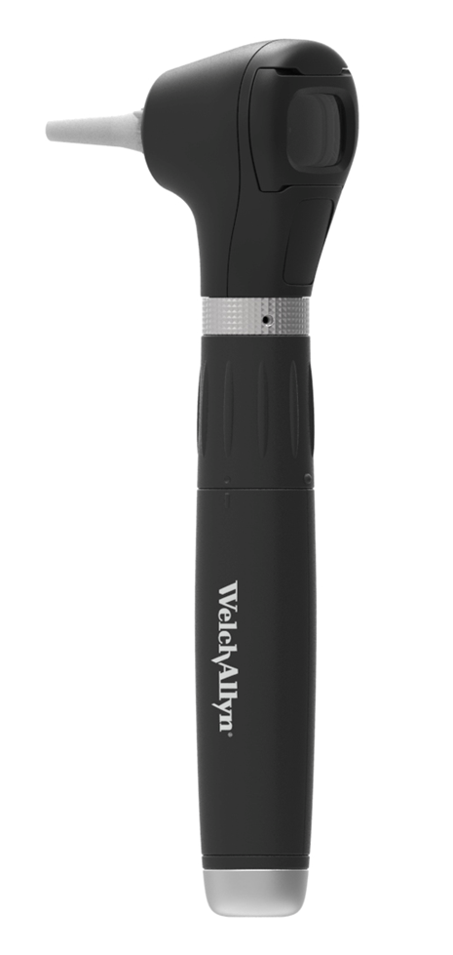
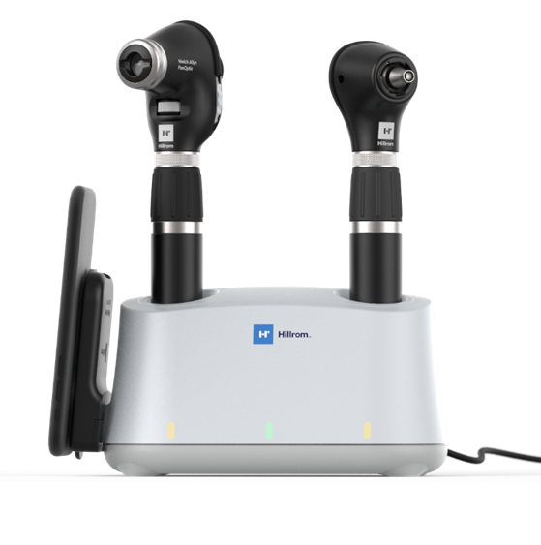

Product Offer Today versus Tomorrow
Good | Better | Best
Good | Better | Best
NiCad handle
719 version handle
warranty

Slide 6
Physical Assessment – Strategy
How Do We Define the Category | Otoscope and Ophthalmoscope sets
What Are Key Market and Competitive Actions? | Expanded role of Physician Assistants and Nurse Practitioners in primary care Doctors office without doctor Purchasing power shifting toward corporate or committee-based purchasing organizations Pricing pressure driving acceptance of good enough products (i.e. low-quality competitors) in professional markets Focus on value-based care driving hospital systems to focus on providing care in lower cost settings. Potential for acceleration of telehealth esp. now with COVID19. Increased usage of digital devices
What does it take to succeed/ outperform the market? | Establish Digital Platform - to capture patient images simplifying diagnosis and treatment of patients Compelling Clinical and Economic Evidence- Influence clinicians to regard physical assessment tools as essential, closed loop diagnostic solutions. Market Development- Expand ophthalmoscope utilization in primary care. Aggressively Expand Channel- Improve engagement and reach to target segments (i.e. student store and underpenetrated markets) Offer complete portfolio incl. dermatosocpe
What are the strategic imperatives that achieve this? | Enhance development and launch Clinical evidence development and KOL engagement Digital commercialization strategy and international channel focus Leverage Vision Care channel Niche markets ( Neurology/ Cardiology)

Slide 7
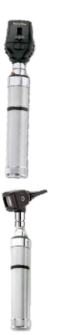

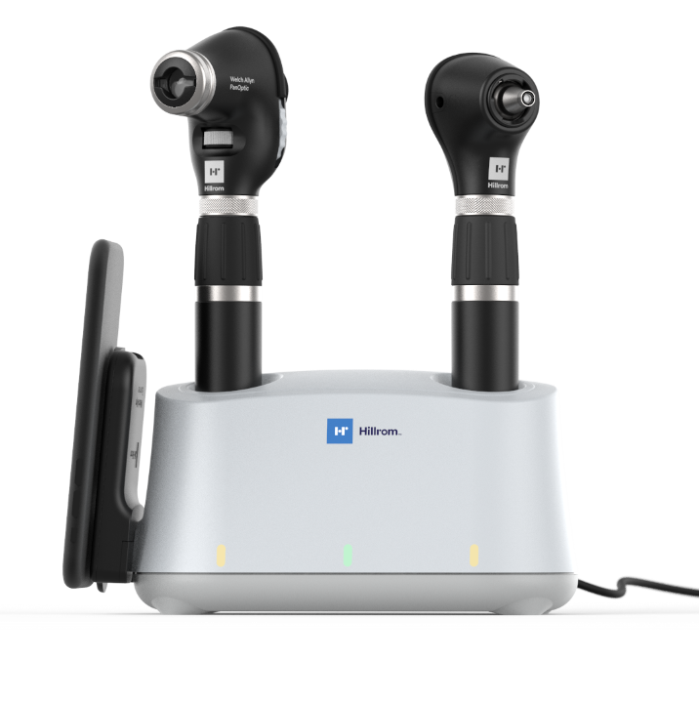
Product Overview
Enhance will deliver a new otoscope and ophthalmoscope with superior optics and ease of use. Each instrument will be capable of quickly capturing digital images to provide better patient care. The project also includes new battery systems and clear specula.
1915-1990
2000
2008
2020

Slide 8
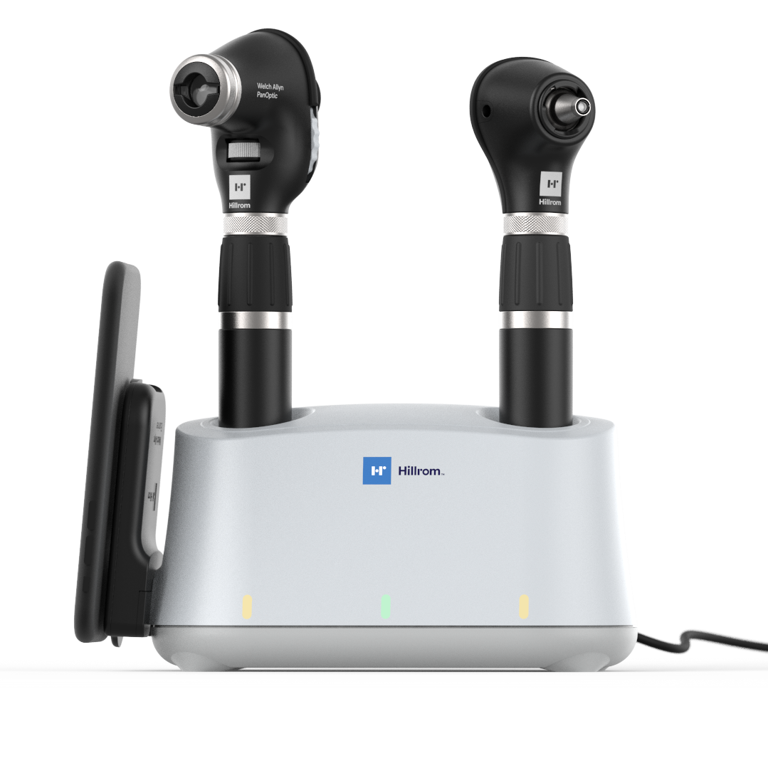
Enhance Profile
Physical Exam & diagnostics
CUSTOMER NEEDS
Increased confidence in physical exams in primary and urgent care facilities Faster exams of the ear and eye Ability to consult with experts and share data Document findings in EMR for tracking and improved patient care
ADDRESSED
BY
SOLUTION DESCRIPTION
NEW MacroView digital otoscope, with clear ear specula 3x field of view and 3x the light for a larger, clearer ear exam NEW PanOptic digital ophthalmoscope 20x field of view of eye, with quick to learn design Quick disc alignment for faster ophthalmoscope learning Digital “Plus” for both Ability to quickly digitize every ophthalmoscope and otoscope in your practice Update existing sets on contracts Replaces MacroView, 250 otoscope, PanOptic, and Li-Ion handles and chargers

Slide 9
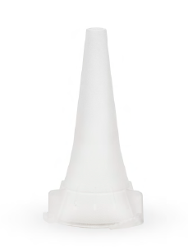
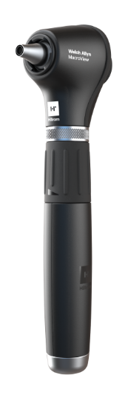
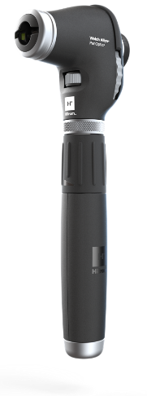
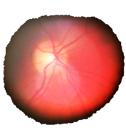


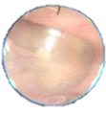
overview
10+ Technologies Make the New PanOptic and MacroView Truly Amazing
PanOptic Basic & PanOptic Plus
MacroView Basic & MacroView Plus
3.
11. Warranty
basic - 1 year
plus – 5 years
3. Durashock™ Extra tough design
10. Lumiview™ Clear Specula
8. Tip grip
1. IExaminer Attachment for Smart bracket & Smart clip (plus only)
9. Focus-free design
7. Quick Eye™ Alignment Technology (Plus only)
6. Traditional ophthalmoscope controls
4.Integrated locking collar (Plus only)
5. Quick brightness adjustment
20x
2. PanOptic™ View
And MacroView™ dramatically more than traditional scopes
3x
0. LED illumination for battery life and durability
12. Auto-off after 3 minutes

Slide 10

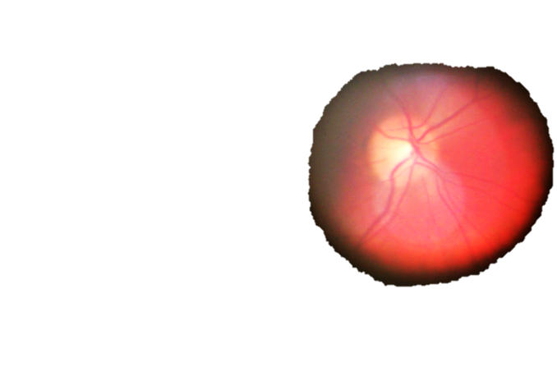
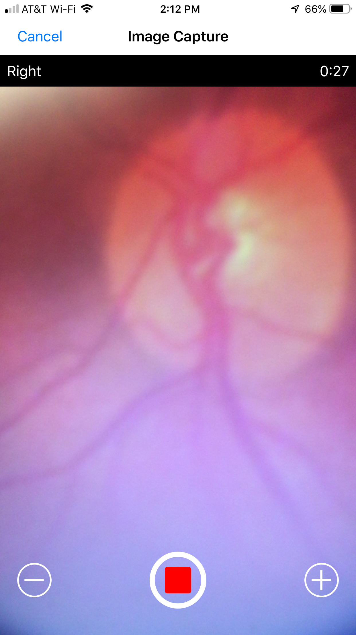

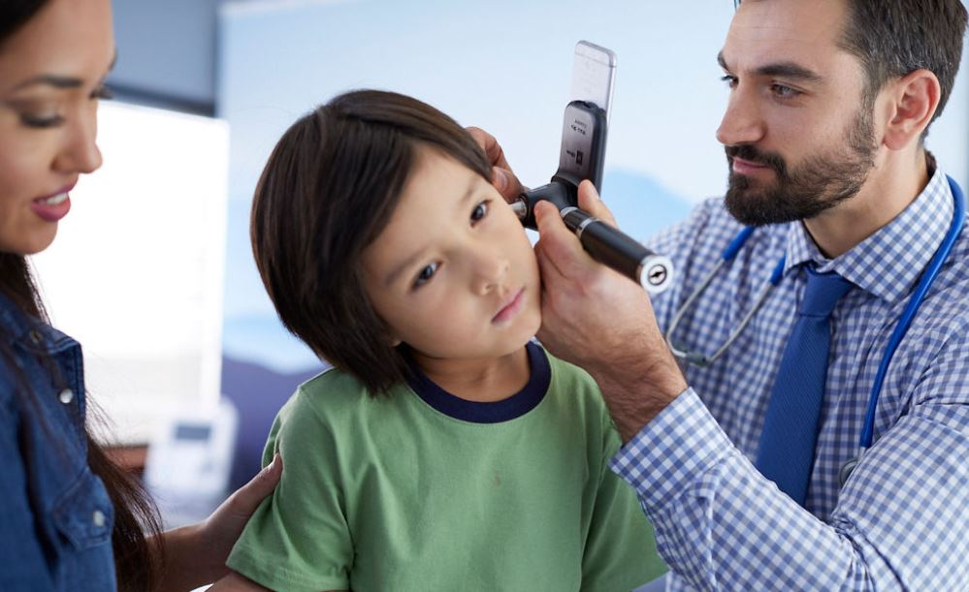
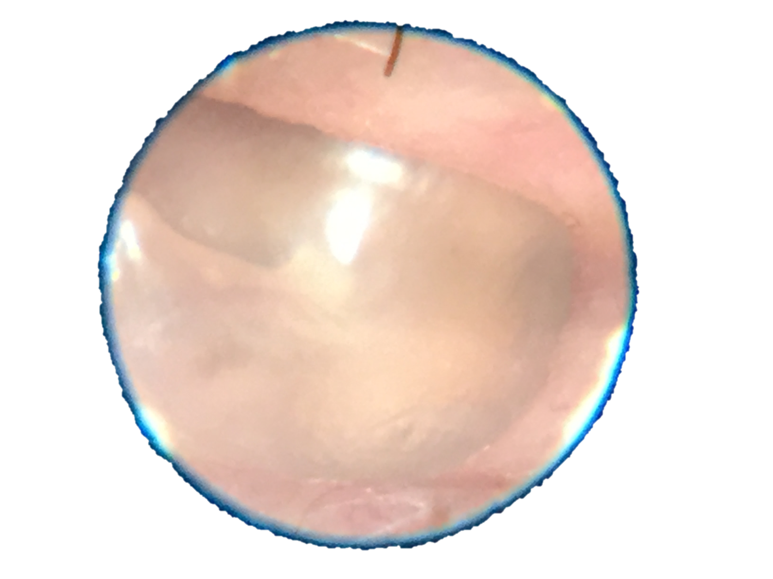
Traditional Scopes with Incredible Views & Quick Digitization
Physical exam & diagnostics
The NEW PanOptic Plus digital ophthalmoscope will transform the way doctors do an eye examine.
Instead of a fleeting image, they will be able to see 20X more than they do today, all while capturing an image using a smart device for further review and consult with a specialists.
20x
The NEW MacroView Plus digital otoscope, with the NEW clear ear specula, will transform the way doctors examine the ears with 3X the field of view and 3X the light for larger, clearer ear exams.
And, by attaching a smart device, images can be saved and shared for improved assessments.
3x

Slide 11
Competitive Product/Service Benefit Ladder
T1
T2
PanOptic-3 and MacroView-3 | Do-nothing/117
Increased confidence as a clinician with additional diagnostic power Better patient outcomes/experience to detect problems earlier without expensive tests Advanced: more connected and innovative Exciting and interesting to use compared to old device | Comfortable Familiar Costs less Maintaining status quo
Efficient exam More accurate diagnosis and referrals Easy-to-use devices Ability to share/upload images Compare and contrast exams Improved patient interaction with images | No budget required
Digitally compatible with side range of smart devices Increased views of eye/ear Quick Eye Alignment (target optic disc) Brighter otoscope exams Better ergonomics/form factor Better durability LED lamps for longer life | Free Durable and reliable product
Emotional Benefit
Functional Benefits
Technical or Product Attributes

Slide 12
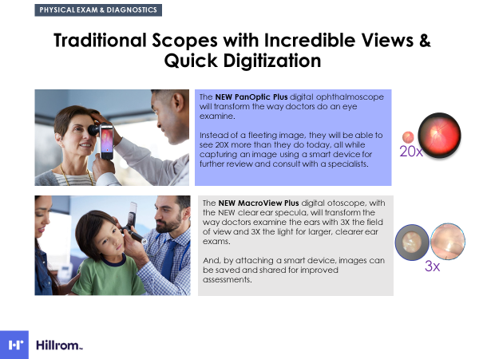
10 reasons why ENHANCE is so exciting for us!
Time for something new( Last significant innovation within the PA segment was MacroView in 2003)
Margins for PA still 55% ( 2nd highest after Vision Care)
~95% indirect business
PanOptic& MacroView still leading technology
Analog/ Hybrid Offer (fully Digital to follow)
New handles
New Clear specula
Opportunity to implement ophthalmoscopy as a standard examination
Excellent customer feedback

Slide 13
“What isn’t there to like” – my interest goes up 4x just like the image”
“Dramatically improved”
“This is text book, text book – this is perfect”
“That large I can make a diagnosis myself”
I could check for papilledema myself the first time
First time I see the background of the eye like this.
WOW, I have never seen such type of detail before
“(with this)…I would not think twice about using an Ophthalmoscope, I would just pull it out and use it”
With such a type of device I would use an ophthalmoscope regularly
Such a great result using this device the first time
“This would make it more fun…get the view right away, then you get your pathology”
“Beautiful”
“To me, this (eye) is more dramatic than other image”
“I can see the pathology better and feel more confident in my diagnosis”
“Huge improvement on blood vessels – a gazillion times better”

Slide 14

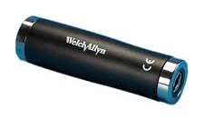
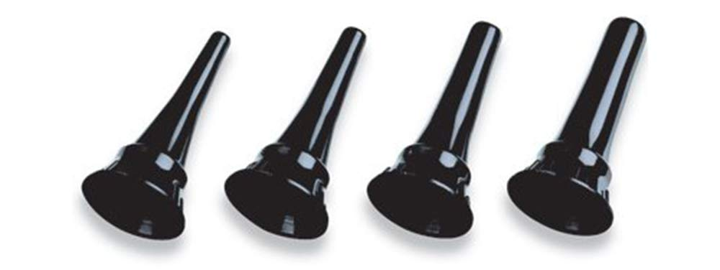

EMEA Financials /Portfolio Overview/Impact
Still required for installed base
New transparent specs as an additional offer
New heads only
Partial replacement
Significant Substitute with new ENHANCE series

Slide 15
Enhance Executive Summary – EMEA
Physical exam & diagnostics
OBJECTIVE | Transition existing “analog” users to the new Standard of Care in Physical Assessment by using SMART Hybrid Tools enabling exceptional views, digital image capture, and file sharing capabilities that empower clinicians to diagnose and treat patients earlier. With ENHANCE, users can rely on the familiarity of “Analog Devices “ but at the same time enjoy the benefit of digital technology.
GOALS | Yr 1 Revenue: approx. 1.2 Mio, CAGR:3%
 | Increase the Usage of Ophthalmoscopes within the Primary Care Market& Specialty market |  | Upgrade Installed Base (Own and Competitive Devices)
KEY STRATEGIES | Promote& Educate Create awareness around the simplicity of the ENAHNCE Ophthalmoscope ( You can only treat what you see) |  | Upgrade Key Opinion Leader Achieve speedy installation by focusing on superior quality combined with future ready technology within high impact customer segment |  | Drive Broader Customer Awareness Accelerate replacement through wide ranging integrated sales & marketing communications esp. in the Digital segment
CHANNEL & PROGRAMS | Digital Channel Communicate benefits& ease of use Free trial program (See it to believe it) Offer online/live symposium for certain cases | Key Opinion Leader/ Associations Equip key Opinion leader Program with dedicated physician Associations | Early Adopter & Telehealth Leaders Free trial program Offer Trade-in Program Establish EMR relation program | Medical Schools Leverage Ophthalmology professors to gain entrance Launch Student program Promote Digital as the new Standard of Care Past Covid-19 program | Multi-Media Presence Always on Search (Google & Amazon) Social Media Online Videos Promote clinical studies Regular Symposium Webshop activities | Traditional Field Sales Focus Distributor Rep program Distributor Sales Promotions Leverage Spot/ RetinaVue Multilingual training program Adapter program
MEASURES | Revenue growth Sales per segment | Revenue Growth Sales per Segment | Key studies underway and published | SEP renewals Enhance sales New SEP contracts | CTR Revenue No. of Participants in various symposium Ratings | Tradeshow workshops Sales No of conversions

Slide 16
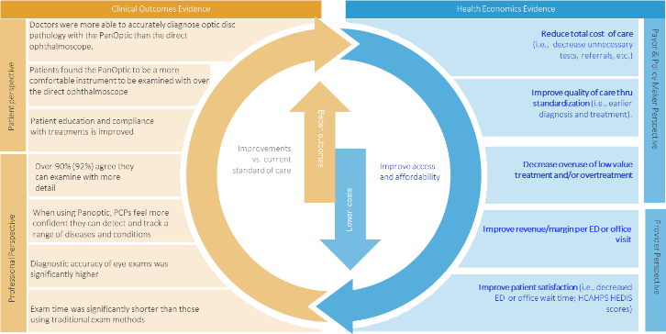
Market Development Assessment
Clinical & Health Economics Evidence
Extensive number of marketing claims support marketing materials
78 values of clinical product and clinical context claims
Tools to create
        Reimbursement
        Payback calculators
        Optimal care plans
Notes:
For example: Over 90% (96%) of physicians feel more confident, that they could detect and track a range of systemic and ocular diseases using a digital ophthalmoscope system (118-3 and iExaminer system) than a traditional ophthalmoscope.

Slide 17

















Some Key Opinion Leaders
 | Name | Title | Institution | Country
 | Y. Joyce Liao | Director, Neuro-Ophthalmology |  | USA
 | Malathi Srinivasan | Clinical Professor of Medicine |  | USA
 | Joseph Wiedemer | Associate Professor of Family Medicine |  | USA
 | Blair Pollitt Golden | Assistant Professor of Medicine |  | USA
 | Chrisfouad Raif Alabiad | Associate Professor Ophthalmology |  | USA
 | Name | Title | Institution | Country
 | Manbir Nigra | Senior Fellow, Vision and Eye Research Institute |  | UK
 | Kiyoshi Shikino,MD, PhD | Professor General Medicine |  | Japan
 | Hamish Dunn | Ophthalmologist & Researcher |  | Australia
 | Drew Reynolds | Clinical Assistant Professor/Residency Program Director |  | USA
Notes:
We’ve developed an impressive KOL list; 81 physicians around the world are able to help us in various ways. Here are the top sites that have agreed to various studies to evaluate the clinical benefits of the iExaminer

Slide 18
Clinical Evidence EMEA
Med schools
Associations
(Pediatricians, GP´s, Neurologists, Orthoptists)
White Paper
Video (Educational/ Promotional)
Expert Opinion /Quotations
Studies
User Report
Unboxing
Comparison Paper
Reference site
Diagnosis101

Slide 19
EMEA Update
Launch date End of Q1
Tier 1 & Tier 2 countries
BENELUX, UK, DACH, GULF, KSA Tier 1
Poland, IBERIA, Italy, SA, India, NORDICS, LAT Tier 2
Launch plans completed by mid of September
Panel presentation for end of September ( Financial Incentive for best plan )
Marcom
brochures, spec sheet, updated Diagnosis 101, studies, evidence Claim (Global), Digital presentation
EMEA Key Activities
Re-introduce ophthalmic examination to the GP market
White paper, Digital event, Clinical study
Approach Niche markets
Optometrists, Opticians, hearing care professional, Neurology, Cardiology
Webinar on Neurology eye examination
Focus on Telehealth
Leverage the new NORMAL (Post Covid)

Slide 20
Possible Obstacles
Portfolio
missing dermatoscope/dermatoscope range
Focus/ Incentive
direct sales force
distributor portfolio
Limited number of events/ direct contact
Standardization/ one supplier
Connectivity
AI use
COVID uncertainty

Slide 21
Market Dynamics and Financial Goals
PRIMARY LAUNCH OBJECTIVE: Convert existing customers in US to update and upgrade. Expand market share OUS, especially against Heine and Riester in EU, ANZ, and Canada
[Product] GOALS
 | YEAR 1 | YEAR 2 | YEAR 3
Incremental Revenue | $3M | $11M | $15M
Margin % | 67% | 67% | 67%
ASP | $236 (blended mix of products)
GP $ | $81M | $86M | $89M
Investment | Total Project $15M
2021
CAGR: 5%
Inc. Share
Total Share
Project focuses on accelerating buying cycle, rather than stealing share in US
33%
50%
21%
16%
11%
8%
35%
26%
MARKET DEFINITION:
Current purchasers and installed base of Physical Exam equipment, including primary care, specialists, and emergency departments worldwide
OPPORTUNITIES & RISKS:
Very large installed base of Welch Allyn product in US
Sales team focus
Dramatically improved basic exam equipment

Slide 22
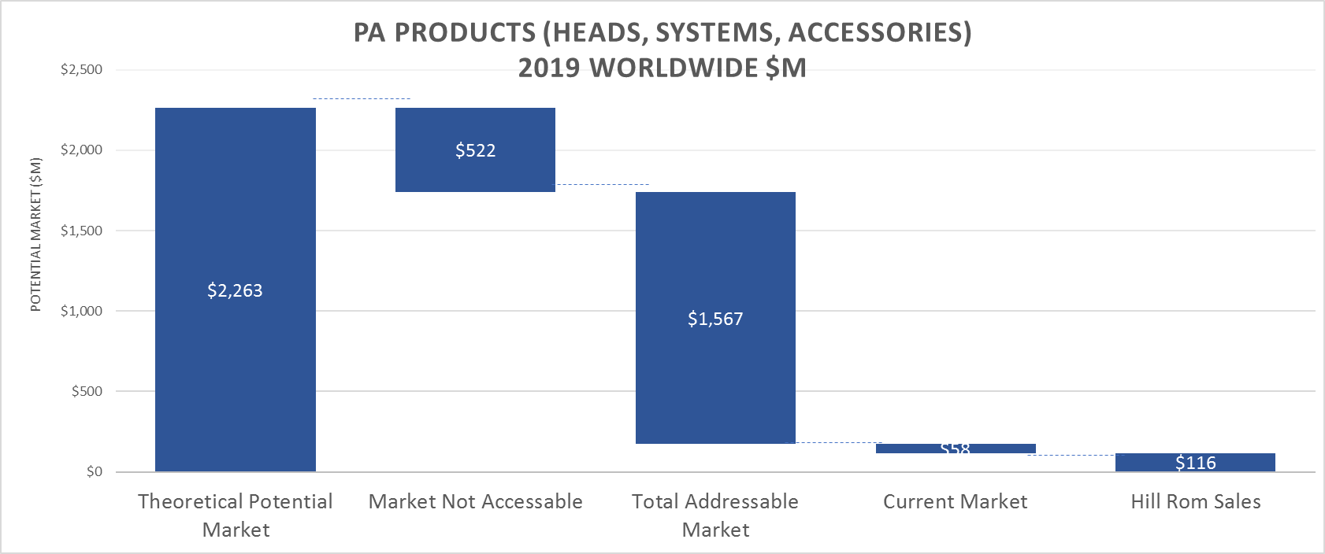
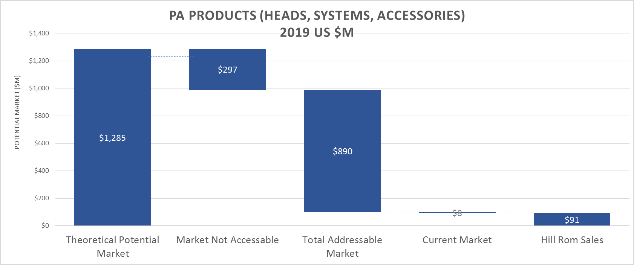
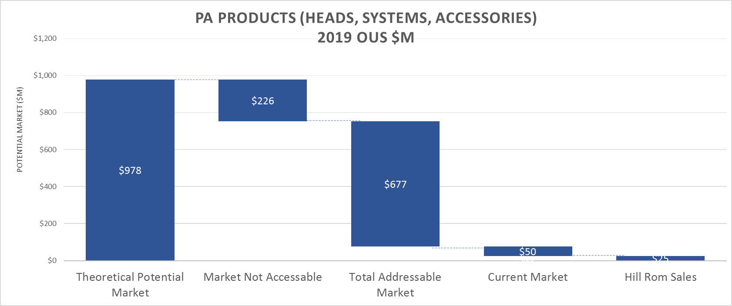
Future Market Size: Waterfall from Potential to Current
T1

Slide 23
Country Specifics

Slide 24
Overview Distributor Belgium
Tier 1 Countries
Arseus Medical Primary Care
Barthels Medical Primary Care
Deforce Medical Primary Care
Medipost Primary Care
Medilor Primary Care
Hospidex Acute Care/Hospital

Slide 25
Overview Distributor The Netherlands
Tier 1 Countries
Daxtrio Primary Care
DSN-Trade Primary Care
Henry Schein Medical Primary Care
Mediq Medeco Primary Care

Slide 29
Heine as the Key Competitor

Slide 30
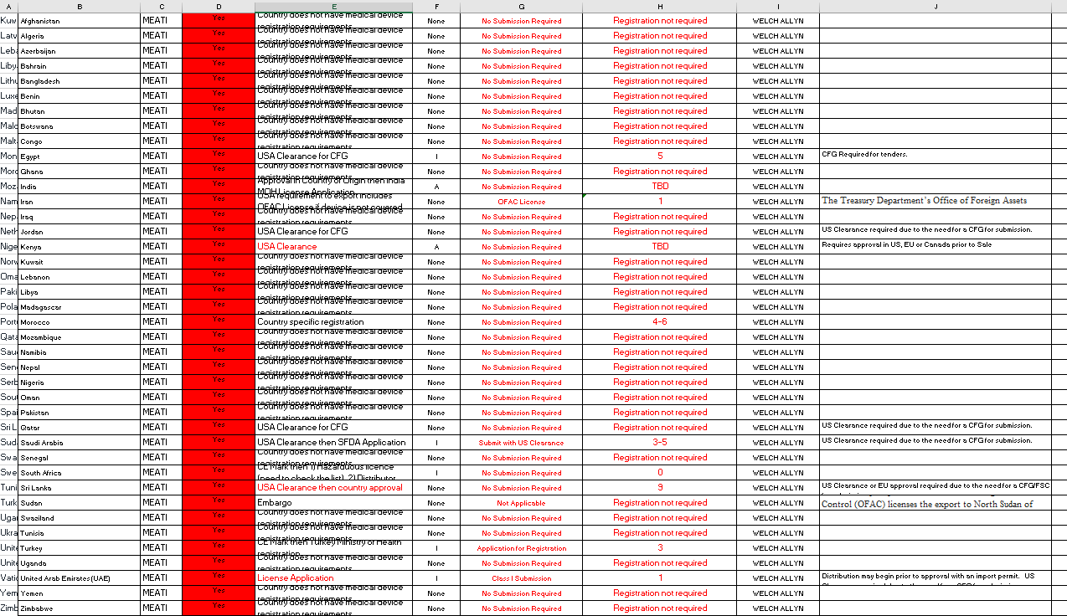

Countries in Scope
MEATI
Europe

